Slide 1
Introduction to Computer Vision
9-10. Optical flow & object tracking
02.12.22
Mikhail Belyaev

Slide 2
Optical Flow
Lucas-Kanade method
Sparse Optical Flow
Dense Optical Flow
Object tracking

Slide 3
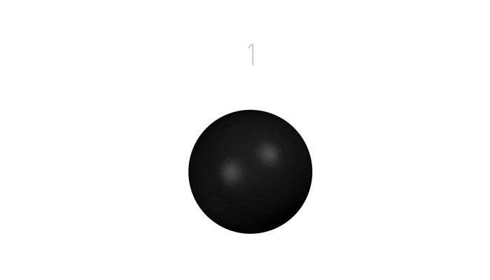
Optical flow
Definition: optical flow is the apparent motion of brightness patterns in the image
Note: apparent motion can be caused by lighting changes without any actual motion
Think of a uniform rotating sphere under fixed lighting vs. a stationary sphere under moving illumination
GOAL: Recover image motion at each pixel from optical flow
Source: Silvio Savarese

Slide 4
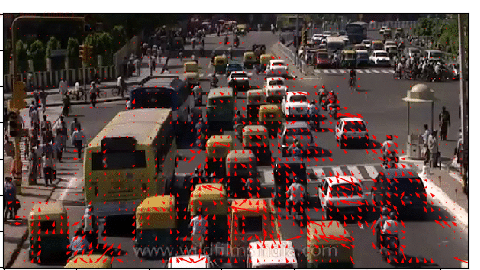
Optical Flow

Slide 5
Estimating optical flow
I(x,y,t–1)
I(x,y,t)
Given two subsequent frames, estimate the apparent motion field u(x,y), v(x,y) between them
Key assumptions
Brightness constancy: projection of the same point looks the same in every frame
Small motion: points do not move very far
Spatial coherence: points move like their neighbors
Source: Silvio Savarese

Slide 6
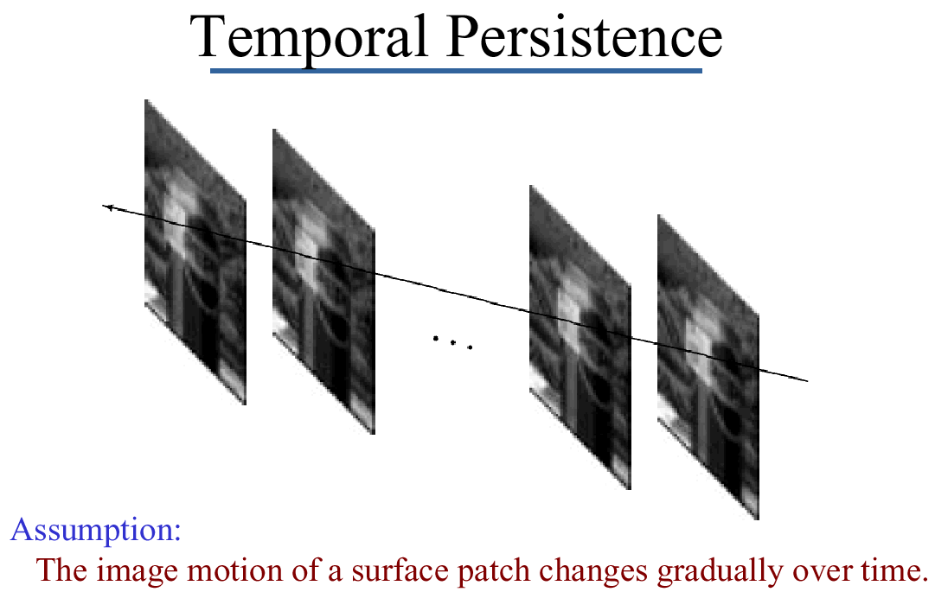
Key Assumptions: small motions
* Slide from Michael Black, CS143 2003

Slide 7
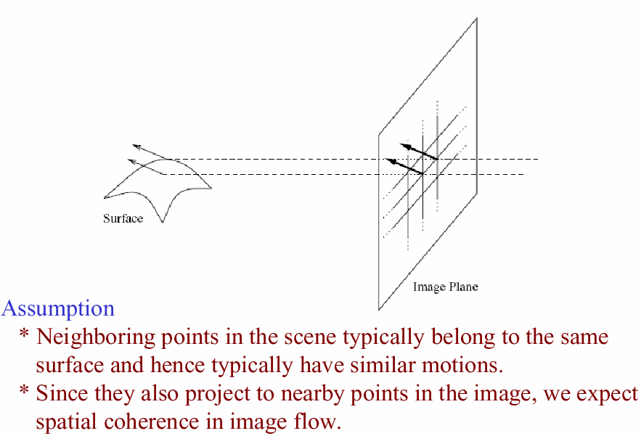
Key Assumptions: spatial coherence
* Slide from Michael Black, CS143 2003

Slide 8
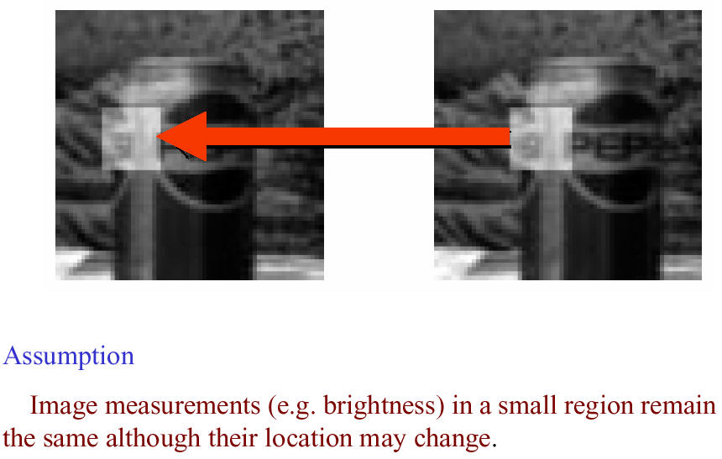
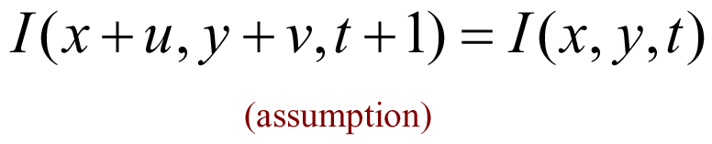
Key Assumptions: brightness Constancy
* Slide from Michael Black, CS143 2003

Slide 9
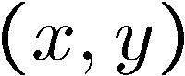
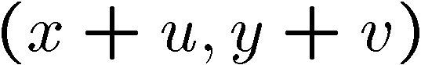

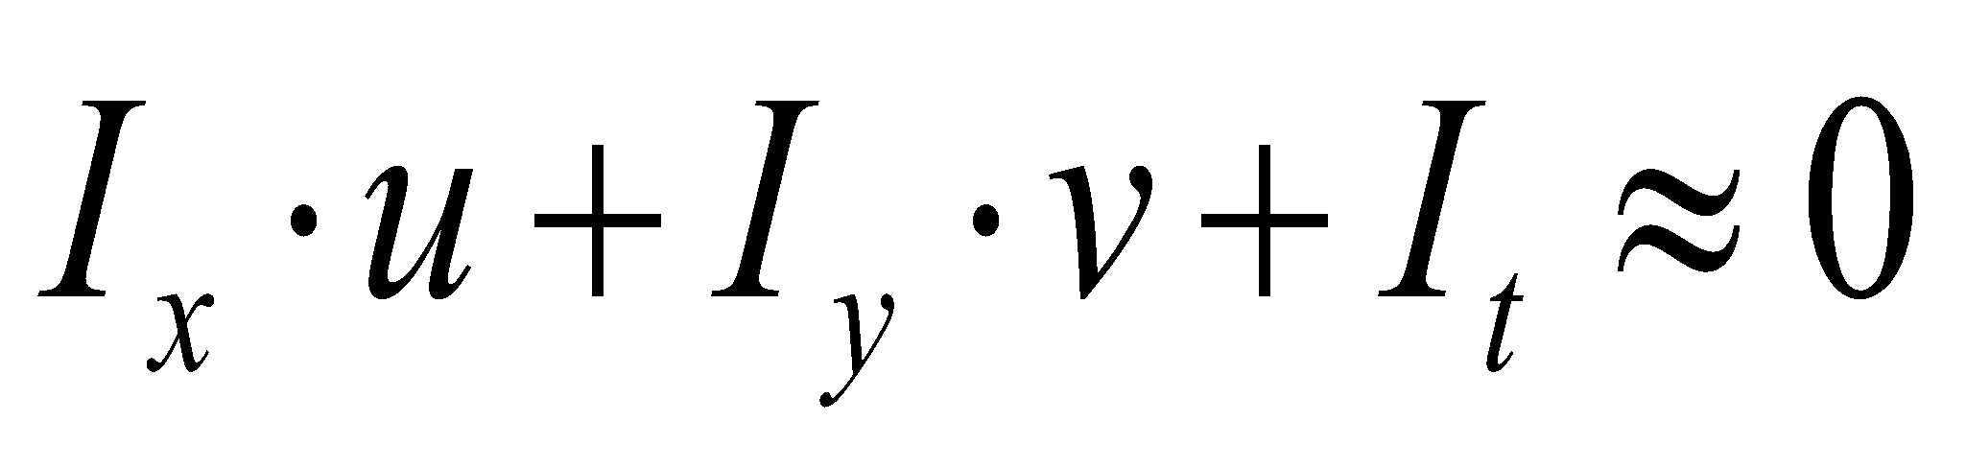
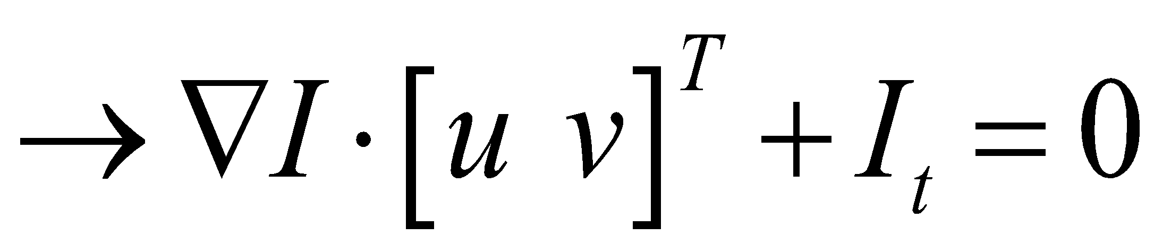
The brightness constancy constraint
I(x,y,t–1)
I(x,y,t)
Brightness Constancy Equation:
Linearizing the right side using Taylor expansion:
Image derivative along x
Source: Silvio Savarese
Hence,

Slide 10
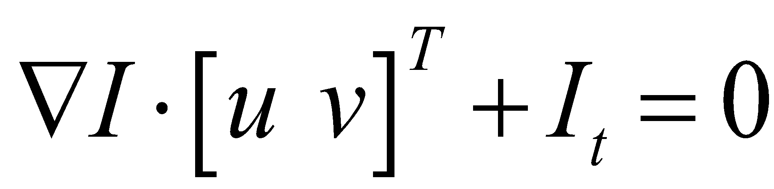
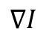
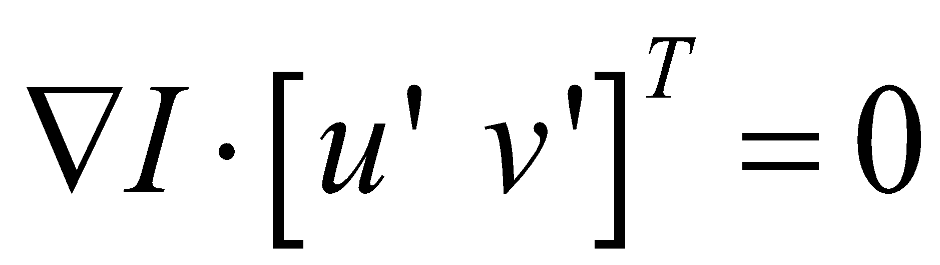
The brightness constancy constraint
Can we use this equation to recover image motion (u,v) at each pixel?
How many equations and unknowns per pixel?
One equation (this is a scalar equation!), two unknowns (u,v)
The component of the flow perpendicular to the gradient (i.e., parallel to the edge) cannot be measured
gradient
(u,v)
If (u, v ) satisfies the equation, so does (u+u’, v+v’ ) if
(u’,v’)
(u+u’,v+v’)
Source: Silvio Savarese
edge
Notes:
A: u and v are unknown, 1 equation
sol: use a neighborhood of pixels to get more equations, assuming all pixels in the neighborhood have the same motion!
Suppose (u,v) satisfies the equation,
now let's add a u',v' component
since u',v' is perpendicular to the gradient, the dot product of u'v' is zero!
then u+u', v+v' also satisfies the equation.

Slide 11
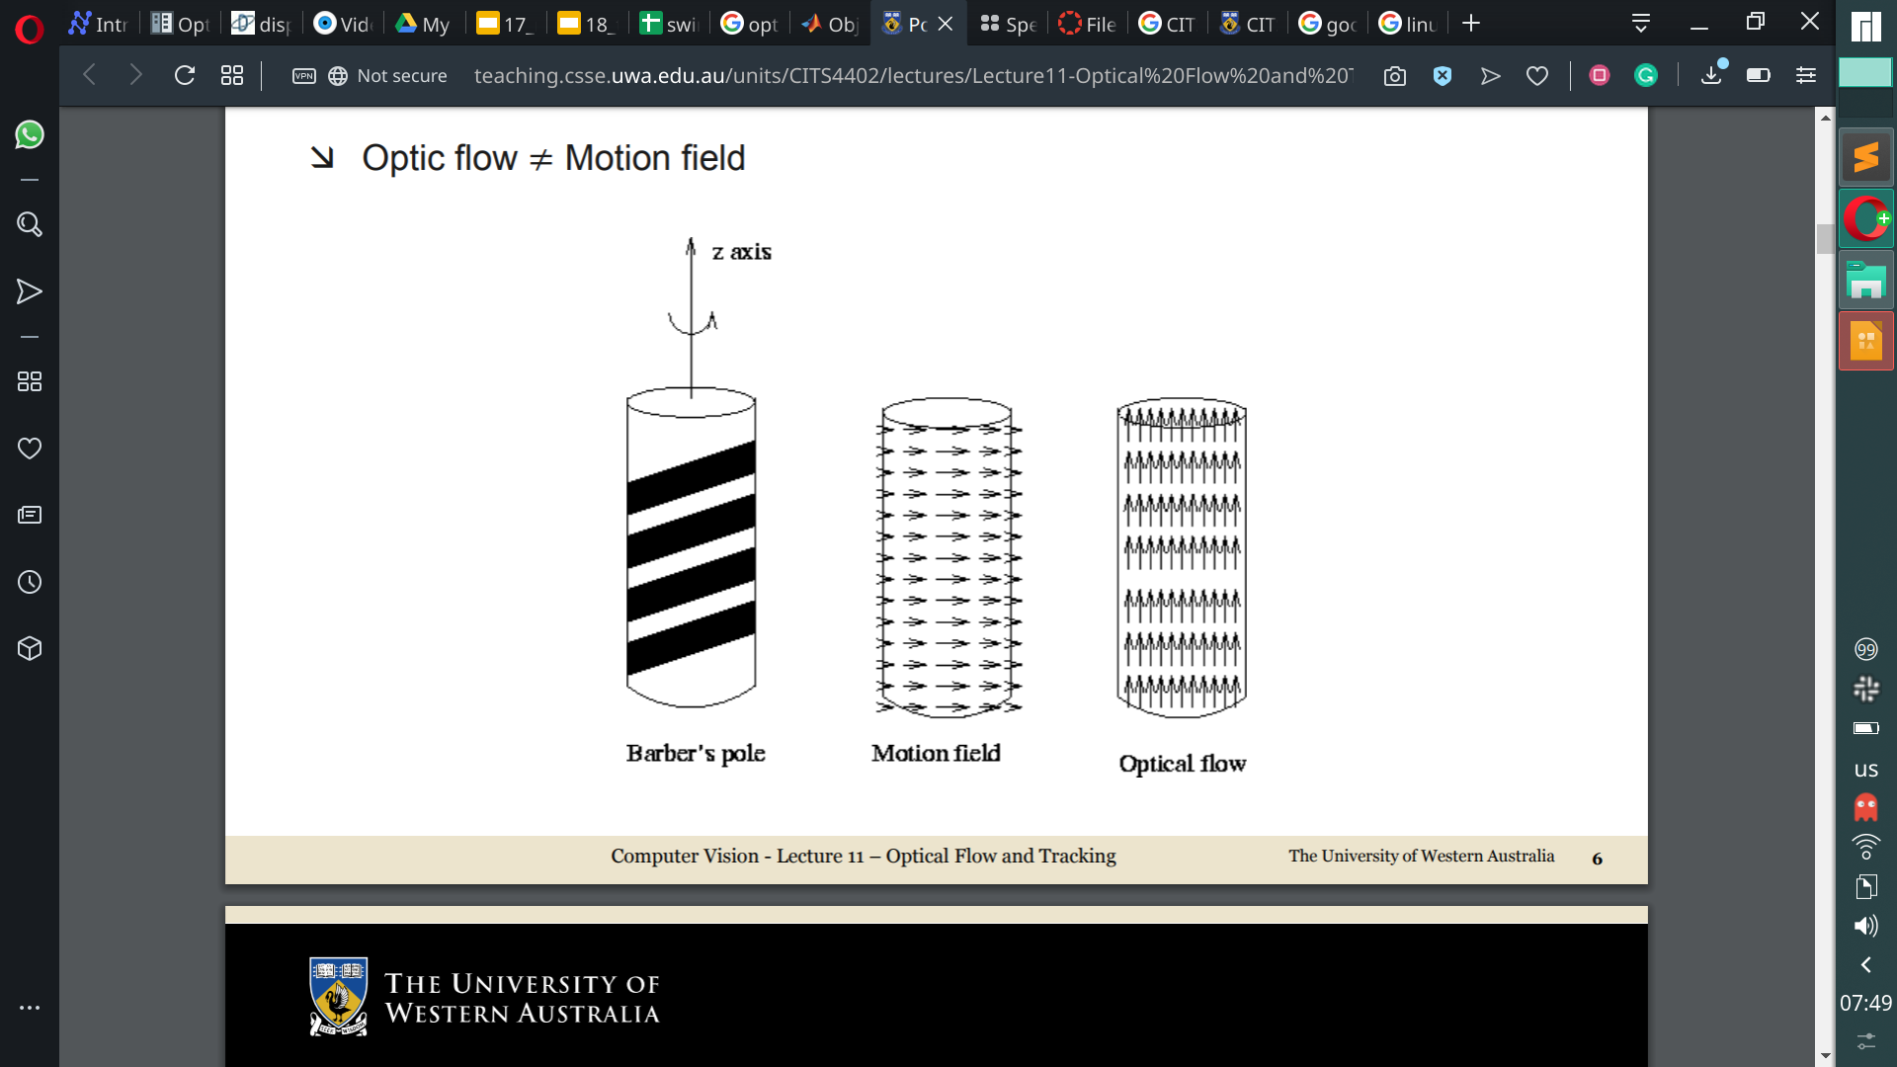
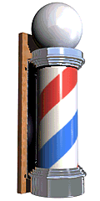
Source: Wikipedia
Notes:
A: u and v are unknown, 1 equation
sol: use a neighborhood of pixels to get more equations, assuming all pixels in the neighborhood have the same motion!
Suppose (u,v) satisfies the equation,
now let's add a u',v' component
since u',v' is perpendicular to the gradient, the dot product of u'v' is zero!
then u+u', v+v' also satisfies the equation.

Slide 12
Source: Ajmal Mian
Notes:
A: u and v are unknown, 1 equation
sol: use a neighborhood of pixels to get more equations, assuming all pixels in the neighborhood have the same motion!
Suppose (u,v) satisfies the equation,
now let's add a u',v' component
since u',v' is perpendicular to the gradient, the dot product of u'v' is zero!
then u+u', v+v' also satisfies the equation.

Slide 13
Optical Flow
Lucas-Kanade method
Sparse Optical Flow
Dense Optical Flow
Object tracking

Slide 14
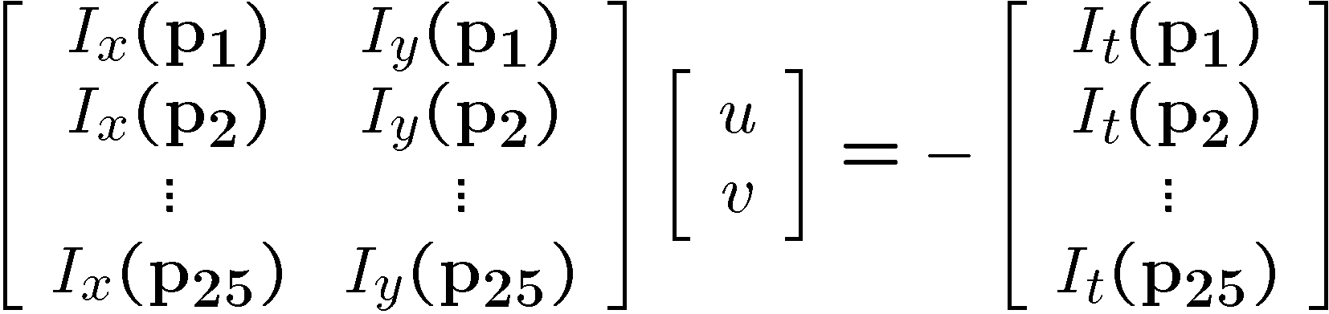
Solving the ambiguity…
How to get more equations for a pixel?
Spatial coherence constraint:
Assume the pixel’s neighbors have the same (u,v)
If we use a 5x5 window, that gives us 25 equations per pixel
Source: Silvio Savarese
B. Lucas and T. Kanade. An iterative image registration technique with an application to stereo vision. In Proceedings of the International Joint Conference on Artificial Intelligence, pp. 674–679, 1981.

Slide 15
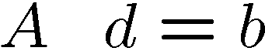
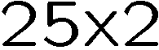
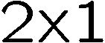
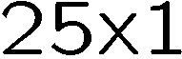
Lucas-Kanade flow
Overconstrained linear system:
Source: Silvio Savarese

Slide 16
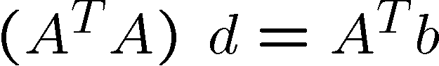
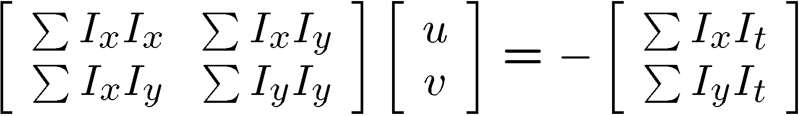
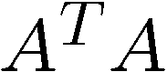
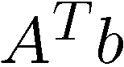
Lucas-Kanade flow
Overconstrained linear system
Least squares solution for d given by
The summations are over all pixels in the K x K window
Source: Silvio Savarese

Slide 17
Lucas-Kanade flow
Optimal (u, v) satisfies Lucas-Kanade equation
When is This Solvable?
A^{T}A should be invertible
A^{T}A should not be too small due to noise
eigenvalues λ₁ and λ ₂ of A^{T}A should not be too small
A^{T}A should be well-conditioned
λ ₁/ λ ₂ should not be too large (λ ₁ = larger eigenvalue)
Source: Silvio Savarese
Does this remind anything to you?

Slide 18
M = A^{T}A is the second moment matrix !
(Harris corner detector…)
“Edge” λ₂ >> λ₁
“Corner” λ₁ and λ₂ are large, λ₁ ~ λ₂
Eigenvectors and eigenvalues of A^{T}A relate to edge direction and magnitude
The eigenvector associated with the larger eigenvalue points in the direction of fastest intensity change
The other eigenvector is orthogonal to it
“Flat” region
“Edge” λ₁ >> λ₂
Source: Silvio Savarese
Notes:
Suppose M = vv^T . What are the eigenvectors and eigenvalues? Start by considering Mv

Slide 19
Limitations
What are the potential causes of errors in this procedure?
Suppose A^{T}A is easily invertible
Suppose there is not much noise in the image
When our assumptions are violated
Brightness constancy is not satisfied
The motion is not small
A point does not move like its neighbors
window size is too large
what is the ideal window size?
* From Khurram Hassan-Shafique CAP5415 Computer Vision 2003

Slide 20
Recap
Key assumptions (Errors in Lucas-Kanade)
Small motion: points do not move very far
Brightness constancy: projection of the same point looks the same in every frame
Spatial coherence: points move like their neighbors
Source: Silvio Savarese

Slide 21
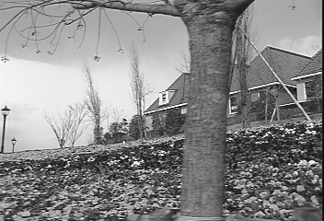
Revisiting the small motion assumption
* From Khurram Hassan-Shafique CAP5415 Computer Vision 2003
Is this motion small enough?
Probably not—it’s much larger than one pixel (2nd order terms dominate)
How might we solve this problem?

Slide 22
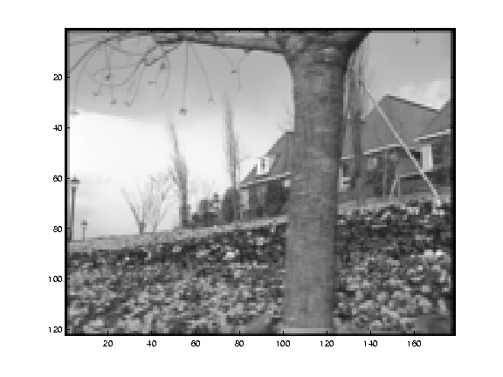
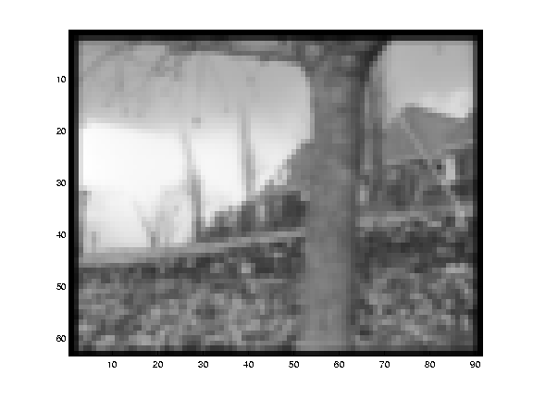
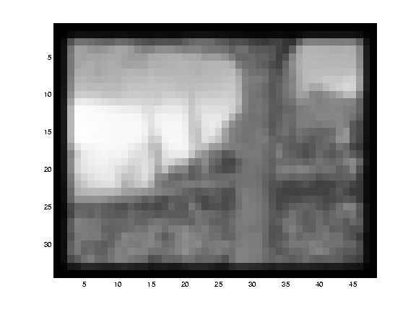
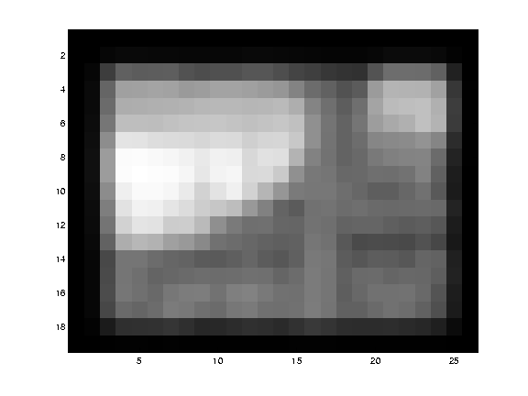
Reduce the resolution!
* From Khurram Hassan-Shafique CAP5415 Computer Vision 2003

Slide 23
Coarse-to-fine optical flow estimation
u=1.25 pixels
u=2.5 pixels
u=5 pixels
image H
u=10 pixels
image I
image 1
image 2
Source: Silvio Savarese
Gaussian pyramid of image 1
Gaussian pyramid of image 2

Slide 24
Coarse-to-fine optical flow estimation
run iterative L-K
warp & upsample
run iterative L-K
.
.
.
image J
image I
image 1
image 2
Source: Silvio Savarese
Gaussian pyramid of image 1 (t)
Gaussian pyramid of image 2 (t+1)

Slide 25
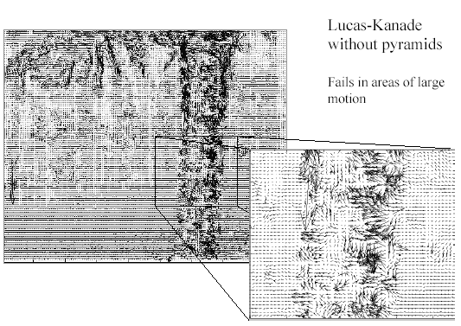
Optical Flow Results
* From Khurram Hassan-Shafique CAP5415 Computer Vision 2003

Slide 26
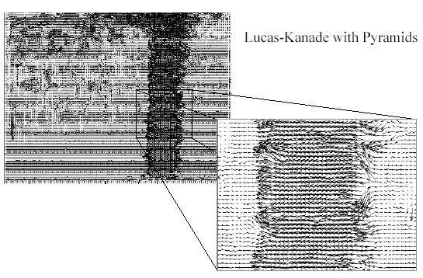
Optical Flow Results
* From Khurram Hassan-Shafique CAP5415 Computer Vision 2003
http://www.ces.clemson.edu/~stb/klt/
OpenCV

Slide 27
Optical Flow
Lucas-Kanade method
Sparse Optical Flow
Dense Optical Flow
Object tracking

Slide 28
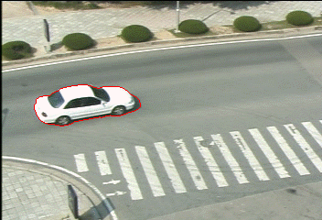
Single object tracking
Source: J. Niebles

Slide 29
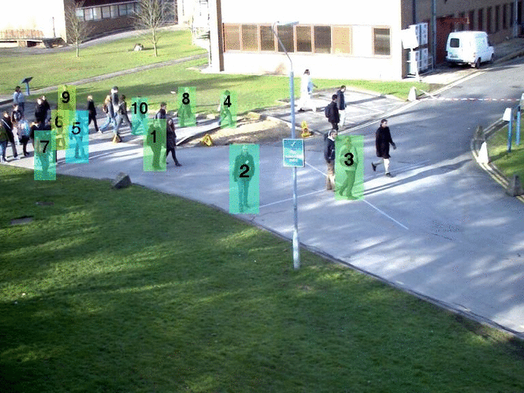
Multiple object tracking
Source: J. Niebles

Slide 30
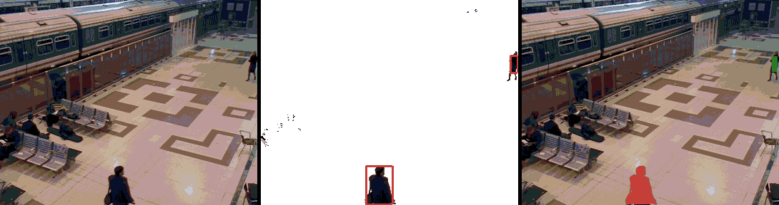
Tracking with a fixed camera
Source: J. Niebles

Slide 31
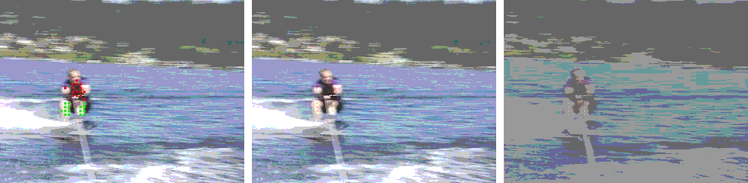
Tracking with a moving camera
Source: J. Niebles

Slide 32
Challenges in Feature tracking
Figure out which features can be tracked
Efficiently track across frames
Some points may change appearance over time
e.g., due to rotation, moving into shadows, etc.
Drift: small errors can accumulate as appearance model is updated
Points may appear or disappear.
need to be able to add/delete tracked points.

Slide 33
What are good features to track?
Can measure “quality” of features from just a single image.
Hence: tracking Harris corners (or equivalent) guarantees small error sensitivity!
Source: Silvio Savarese

Slide 34
Motion estimation techniques
Dense Optical flow
Recover image motion at each pixel from spatio-temporal image brightness variations (optical flow)
Sparse Optical Flow / Feature-tracking
Extract visual features (corners, textured areas) and “track” them over multiple frames

Slide 35
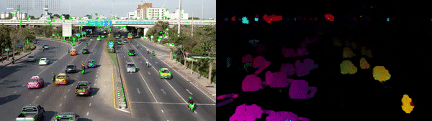
Motion estimation techniques
Source

Slide 36
Simple Lucas-Kanade Tracker
Find a good point to track (harris corner)
For each Harris corner compute motion (translation or affine) between consecutive frames.
Link motion vectors in successive frames to get a track for each Harris point
Introduce new Harris points by applying Harris detector at every m (10 or 15) frames
Track new and old Harris points using steps 1‐3

Slide 37
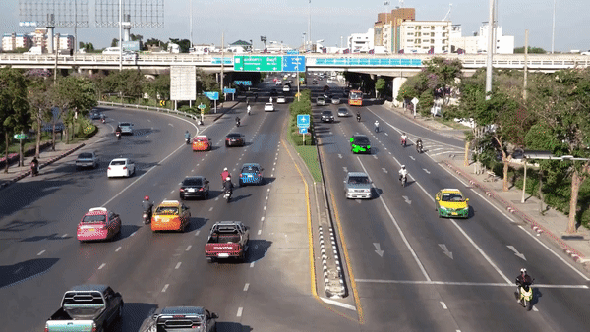
Simple Lucas-Kanade Tracker
We can also track specific objects
How?

Slide 38
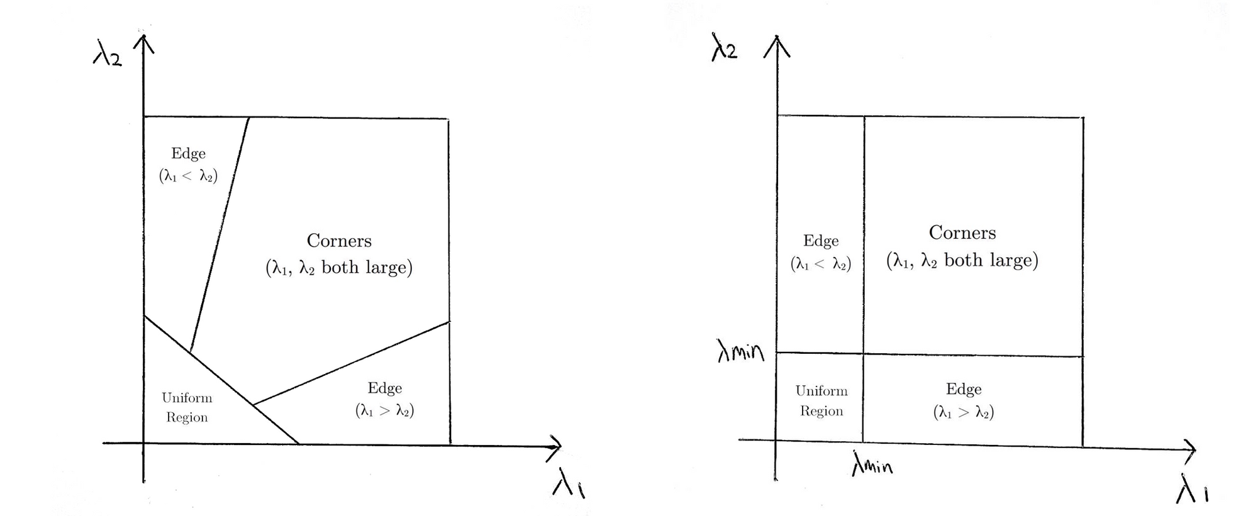
How to detect corners?
OpenCV uses Shi-Tomasi algorithm, a different method to find corners

Slide 39
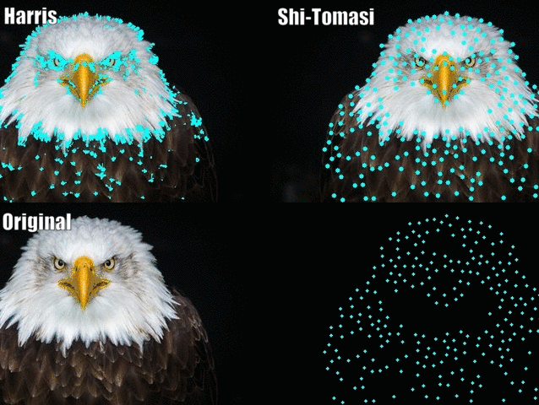
How to detect corners?
A couple of blogposts claim that it’s much better than Harris
Does it look reasonable?

Slide 40
Optical Flow
Lucas-Kanade method
Sparse Optical Flow
Dense Optical Flow
Object tracking

Slide 41
Recap
Key assumptions (Errors in Lucas-Kanade)
Small motion: points do not move very far
Brightness constancy: projection of the same point looks the same in every frame
Spatial coherence: points move like their neighbors
Source: Silvio Savarese

Slide 42
Small motion assumption
How do we represent the motion in this scene?
Source: Silvio Savarese

Slide 43
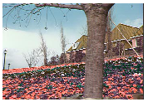
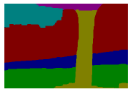
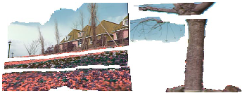
Motion segmentation
Idea: break image sequence into “layers” each of which has a coherent (affine) motion
Source: Silvio Savarese
J. Wang and E. Adelson. Layered Representation for Motion Analysis. CVPR 1993.

Slide 44
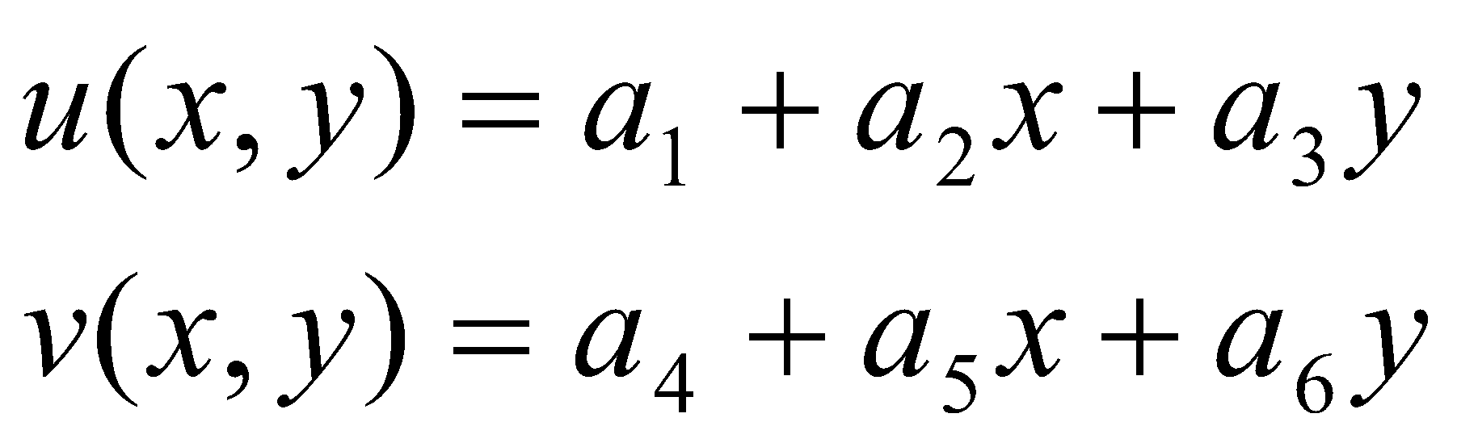
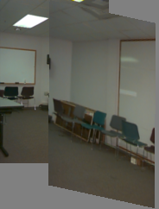
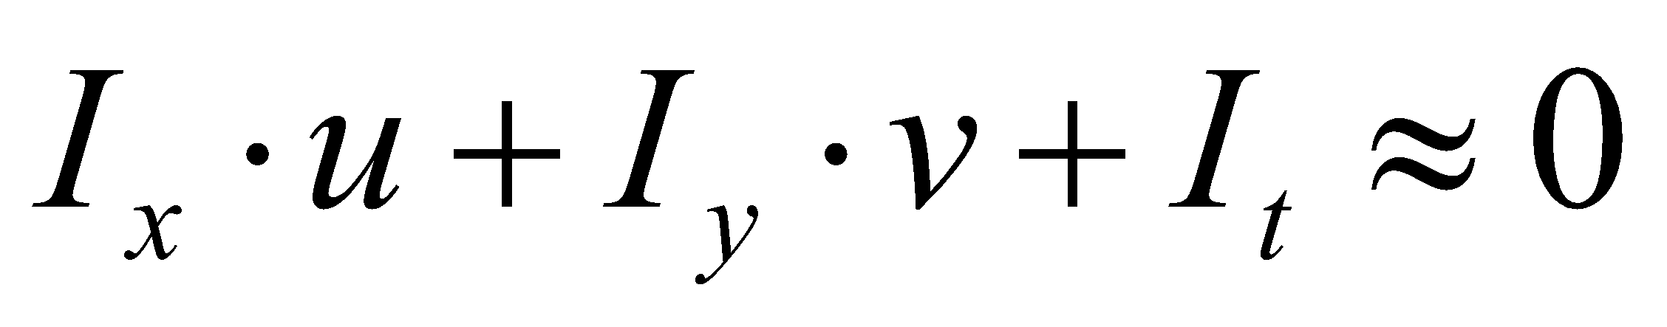
Affine motion
Substituting into the brightness constancy equation:
Source: Silvio Savarese

Slide 45
Affine motion
Substituting into the brightness constancy equation:
Each pixel provides 1 linear constraint in 6 unknowns
Least squares minimization:
Source: Silvio Savarese

Slide 46
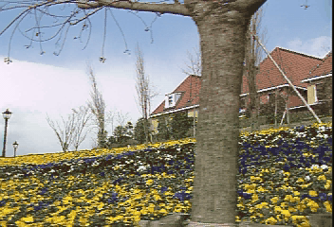
How do we estimate the layers?
1. Obtain a set of initial affine motion hypotheses
Divide the image into blocks and estimate affine motion parameters in each block by least squares
Eliminate hypotheses with high residual error
Map into motion parameter space
Perform k-means clustering on affine motion parameters
Merge clusters that are close and retain the largest clusters to obtain a smaller set of hypotheses to describe all the motions in the scene
Source: Silvio Savarese

Slide 47
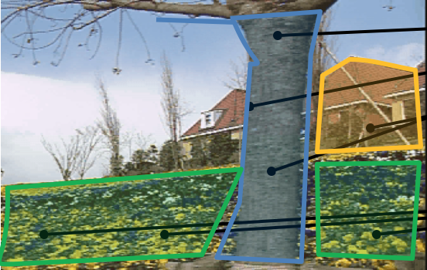
How do we estimate the layers?
1. Obtain a set of initial affine motion hypotheses
Divide the image into blocks and estimate affine motion parameters in each block by least squares
Eliminate hypotheses with high residual error
Map into motion parameter space
Perform k-means clustering on affine motion parameters
Merge clusters that are close and retain the largest clusters to obtain a smaller set of hypotheses to describe all the motions in the scene
Source: Silvio Savarese

Slide 48
How do we estimate the layers?
1. Obtain a set of initial affine motion hypotheses
Divide the image into blocks and estimate affine motion parameters in each block by least squares
Eliminate hypotheses with high residual error
Map into motion parameter space
Perform k-means clustering on affine motion parameters
Merge clusters that are close and retain the largest clusters to obtain a smaller set of hypotheses to describe all the motions in the scene
2. Iterate until convergence:
Assign each pixel to best hypothesis
Pixels with high residual error remain unassigned
Perform region filtering to enforce spatial constraints
Re-estimate affine motions in each region
Source: Silvio Savarese

Slide 49
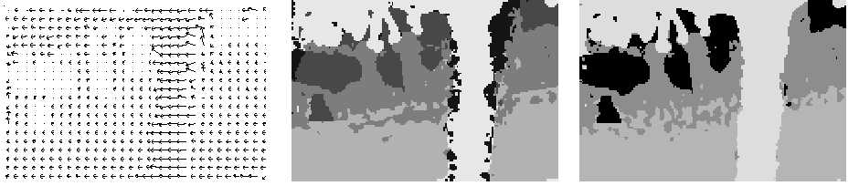
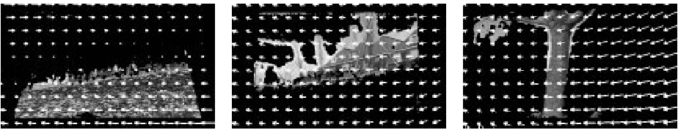
Example result
Source: Silvio Savarese
J. Wang and E. Adelson. Layered Representation for Motion Analysis. CVPR 1993.

Slide 50
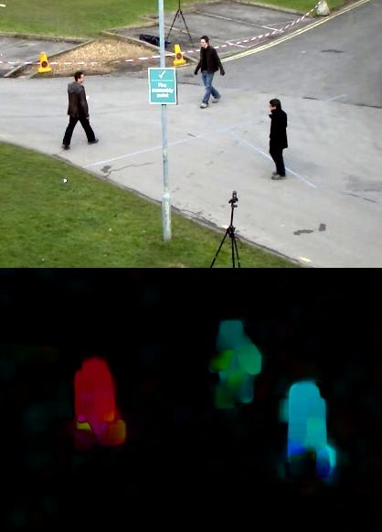
Farneback Optical Flow

Slide 51


Optical flow applications
Optical trackers
Depth estimation
Video compression with codecs
(Some monstrous pipelines for video analysis with deep learning)
Source https://arxiv.org/ftp/arxiv/papers/2003/2003.00766.pdf

Slide 52
Optical Flow
Lucas-Kanade method
Sparse Optical Flow
Dense Optical Flow
Object tracking

Slide 53

Optical trackers
Based on the ideas of optical flow, image correlations with blows and whistles.
There are tons of them: www.pyimagesearch.com/2018/07/30/opencv-object-tracking/
>7 in opencv only
Why so many?
None of them works well enough under
different circumstances.

Slide 54

Optical tracking. Weak spots
It doesn’t take into account objects velocity or direction. Leading to confusions for identical objects
For many kinds of objects it
may be hard to get a robust
detection.

Slide 55


Optical tracking. Weak spots
Sudden changes in the object shape will break it
Object loss is not handled well
Source: https://habr.com/ru/company/recognitor/blog/505694/

Slide 56
Optical tracking. When to use it
When we don’t have a good enough object detection algorithm
Possible reasons:
No labeled dataset
Performance optimisation
Сross-platform usage (opencv, dlib)
Notes:
http://dlib.net/

Slide 57
Tracking. What to use
Suppose we have an object detection algorithm.
A better initial approach would be to process it’s predictions into objects tracks.
https://github.com/abewley/sort
A very good implementation of what can be achieved for tracking without deep learning. Just classic math.
Notes:
http://dlib.net/

Slide 58

SORT algorithm
SORT = simple online and realtime = Kalman filter + Hungarian algorithm
Notes:
http://dlib.net/

Slide 59

SORT. Hungarian algorithm
Hungarian algo solves target assignment problem in polynomial time
How to assign this 3 jobs to 3 people
to make overall cost minimal?
In case of SORT, it’s used to assign detection to the most appropriate tracks.
Source: https://en.wikipedia.org/wiki/Hungarian_algorithm
Notes:
http://dlib.net/

Slide 60
SORT. Kalman filter
Kalman filter combines different measures of a noisy variable to produce a better approximation by estimating a joint probability distributions.
In case of tracks, we get new positions from detector. (noisy, sometimes there are no detections).
Also we can predict future positions based on the object velocity and direction.
Kalman filter combines this 2 estimation in an optimal way.
Notes:
http://dlib.net/

